Slide 1
Exploratory Data Analysis (EDA)

Slide 2
What is EDA
Exploratory data analysis is an attitude, a state of flexibility, a willingness to look for those things that we believe are not there, as well as those we believe to be there.
-John Tukey
Plots and Graphs
Histograms
Box Plots
Density Plots
Pairwise Scatter / Correlation Plots
Time Series Plots
Summary Statistics
Mean
5 Number Summary

Slide 3
Why do EDA?
Long before worrying about how to convince others, you first have to understand what’s happening yourself.
-Andrew Gelman
EDA is not a formal process with a strict set of rules. More than anything, EDA is a state of mind. During the initial phases of EDA you should feel free to investigate every idea that occurs to you. Some of these ideas will pan out, and some will be dead ends. As your exploration continues, you will hone in on a few particularly productive areas that you’ll eventually write up and communicate to others.
-Hadley Wickam

Slide 4
Why Do EDA cont.
gain intuition about the data
comparisons between distributions
sanity check (format, scale)
missing data
outliers
summarize the data

Slide 5
How to do EDA
EDA is fundamentally a creative process.
-Hadley Wickam
Ask questions about your data
These questions will lead to new, more fruitful questions.
Use the aforementioned plots,graphs,summary statistics to answer those questions.
Two main types of questions drive EDA
What type of distribution do my variables follow?
What type of covariation occurs between my variables?

Slide 7
EDA | Visualizing Distributions

Slide 8
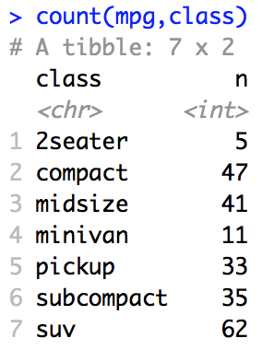
Categorical Variables
mpg %>%
ggplot(aes(x = class, fill = class)) +
geom_bar()
count(mpg,class)
mpg %>%
ggplot(aes(x = class, fill = class)) + geom_bar() +
geom_text(aes(class, totals$n + 2, label = totals$n, fill = NULL), data = totals)

Slide 9
Continuous Variables
mpg %>%
ggplot(aes(x = cty, fill = class)) +
geom_histogram()
mpg %>%
ggplot(aes(x = cty, color = class)) +
geom_freqpoly ()

Slide 10
Continuous Variables
mpg %>%
ggplot(aes(y = cty, color = class)) +
geom_boxplot()

Slide 11
Continuous Variables
mpg %>%
ggplot(aes(x = cty, color = class)) +
geom_histogram() +
facet_grid(rows = vars(class))

Slide 13
EDA | Two Fundamental Parameters
Center and Spread

Slide 14
Center and Spread
Nearly every distribution has two fundamental parameters
Center
Mean
Median
Mode
Spread
Variance / Standard Deviation
Range
Interquartile Range (IQR)

Slide 15
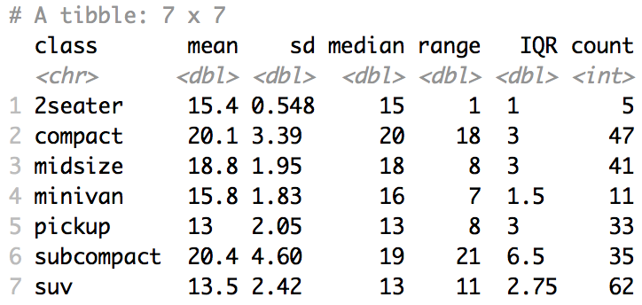
Center and Spread
mpg %>%
group_by(class) %>%
summarize(mean = mean(cty), sd = sd(cty), median = median(cty), range = max(cty)-min(cty), IQR = IQR(cty), count = n())

Slide 17
Break Outs
Unit 6: EDA

Slide 18
Break Out 1
Go over your code from the Asynch Material.
Describe to each other what each line does.
Share a screen and run through your code line by line.
Question 1: Is this a sample or the population?
Question 2 (if there is time)
Play around with any “what-ifs” might come up:
ie. “What if we wanted to look at Male vs Female Click Through Rate?”

Slide 19
End Break Out 1

Slide 20
Break Out 2
At least one breakout member create a PowerPoint in which to record your answers. At the end of the Breakouts, make sure all members of the breakout have a copy for your reference in this and other courses.
Say we want to test if the mean Click Through Rate (CTR) is different for males versus females. Let’s say your client would like to analyze only those clients who have clicked … that is those with clicks greater than 0.
We need to check the assumptions. This could be handled under the EDA.
First: Create a column for CTR in the dataset.
Second: Make two histograms: one for male CTR and one for female CTR.
Third: Make two boxplots: one for male CTR and one for female CTR.
Fourth: Using the histograms and boxplots, address the assumptions of the t-test for comparing the means.
Conduct the T-test using t.test. Just provide the output and the Step 6 conclusion. (REF SLIDE ON NEXT SLIDE!)
Do the best you can and shoot me message if you have a question! THERE IS A t.test REFERENCE ON THE NEXT SLIDE!

Slide 21
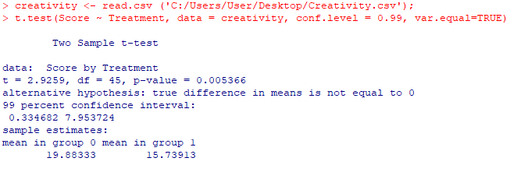
Finding the P-value
Step 6: There is sufficient evidence to suggest that those who receive the Intrinsic treatment have a different mean score than those who receive the Extrinsic treatment (p-value = 0.0054 from a t-test). We can also claim that the mean intrinsic score is greater than the extrinsic one. (The burden of rejecting the null hypothesis for a one-tailed test is less than a two-tailed test, given the test is in the relevant direction.) A 99% confidence interval for this difference is (0.3347, 7.95).

Slide 22
End Break Out 2

Slide 23
Break Out 3
Add these answers to your PowerPoint.
Say now we want to test if the mean Click Through Rate (CTR) is different for different age groups. Note: Here we want to make sure to only look at those who have signed in since they will be the only ones with an accurate age.
We need to check the assumptions. This could be handled under the EDA.
First: Make a histogram of CTR for each of the 7 age groups.
Second: Make 7 side by side box plots, one for each age group. Why are the ”boxes” hard to see? Just for fun, plot the boxplots only for observations with CTR > 0.
Third: Using the histograms and boxplots, address the assumptions of the ANOVA for comparing the means.
Conduct the ANOVA using the aov function in R. Just provide the output and the Step 6 conclusion.
Do the best you can and shoot me message if you have a question!
Do the best you can and shoot me message if you have a question! THERE IS A aov() REFERENCE ON THE NEXT SLIDE!

Slide 24
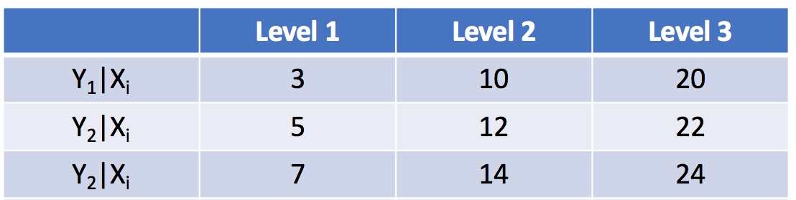
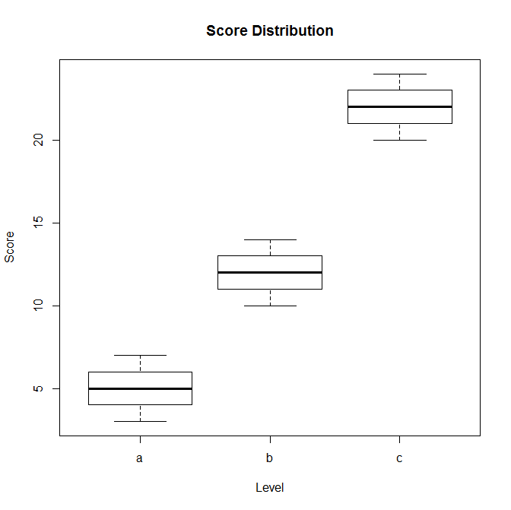
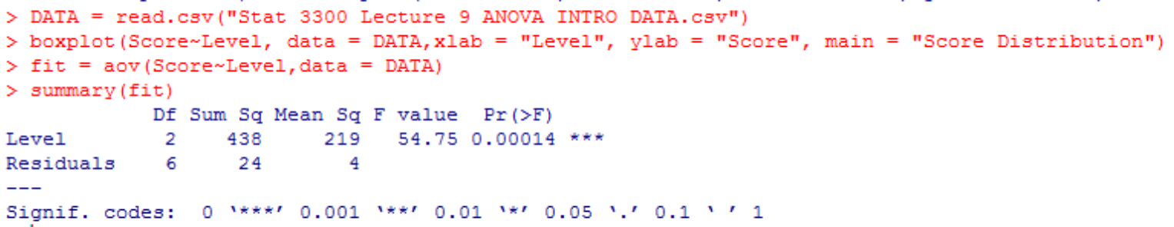
ANOVA in R!
Ho: µ₁= µ₂ = µ₃ (Equal Means Model)
Ha: At least 1 pair are different (Separate Means Model)
There is overwhelming evidence to suggest that at least one pair of means are different between he levels (pvalue = .00014).

Slide 25
End Break Out 3

Slide 26
Break Out 4
Add these answers to your PowerPoint.
Say now we want to test WHICH of the age groups have evidence of different mean CTR.
Note: We still want to make sure to only look at those who have signed in since they will be the only ones with an accurate age.
You goal is to identify which age groups the evidence suggests have different mean click through rates.
Do the best you can and shoot me a message if you have a question!
THERE IS an R function REFERENCE ON THE NEXT SLIDE!

Slide 27
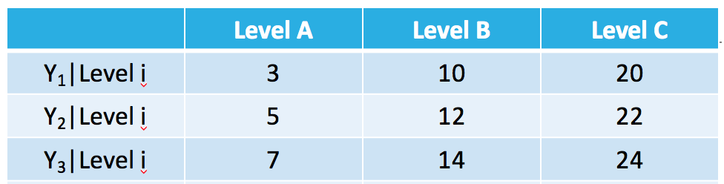
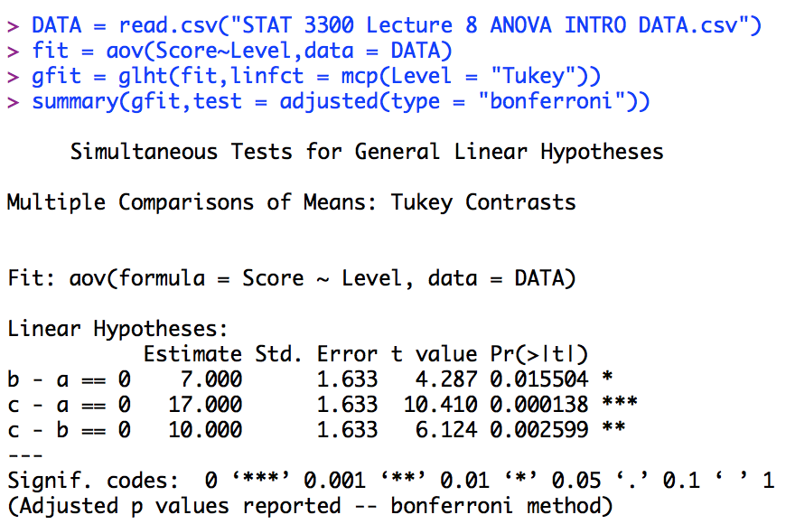
Multiple Comparison Adjustment: Bonferroni in R
This will yield the Bonferroni adjustment to the pvalues.
There is strong evidence to suggest that each of the means are different from each other even after a Bonferroni adjustment for the three simultaneous comparisons. (A more complete answer would include details on each comparisons including pvalues and confidence intervals for the difference.)

Slide 28
End Break Out 4

Slide 29
Appendix: Example EDA
note: ggpairs() is in the GGally package

Slide 30
Example | Diamonds

Slide 31
EDA | A Review
Remember, EDA is a creative process that is driven by your questions.
It is not a formal process.
You should investigate every idea that occurs to you.
Each data scientist’s specific EDA on a given dataset is likely to be different.

Slide 32
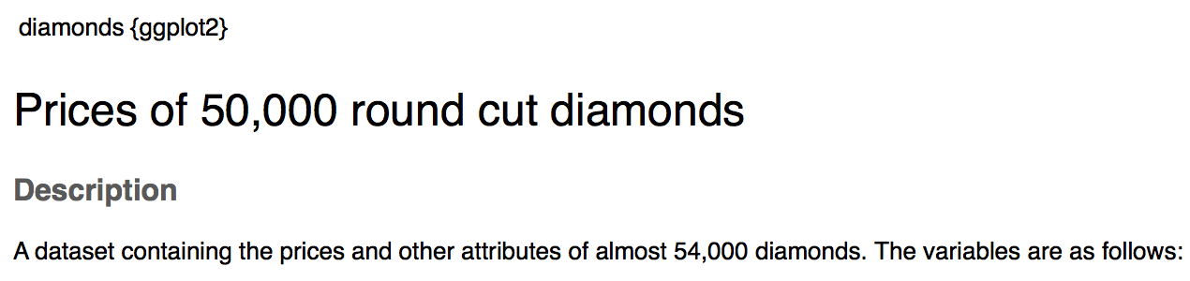
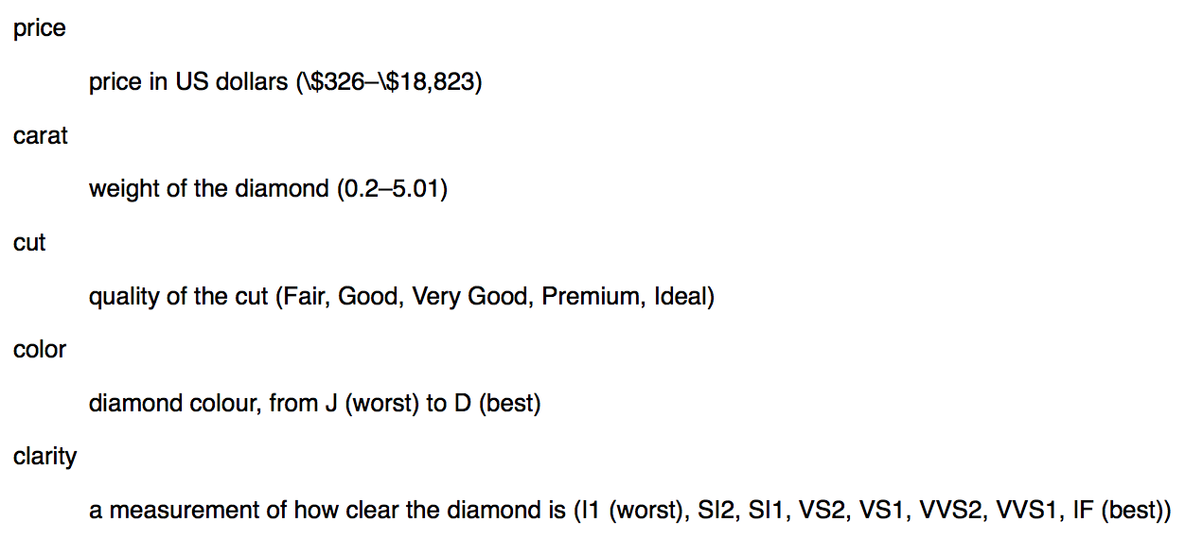
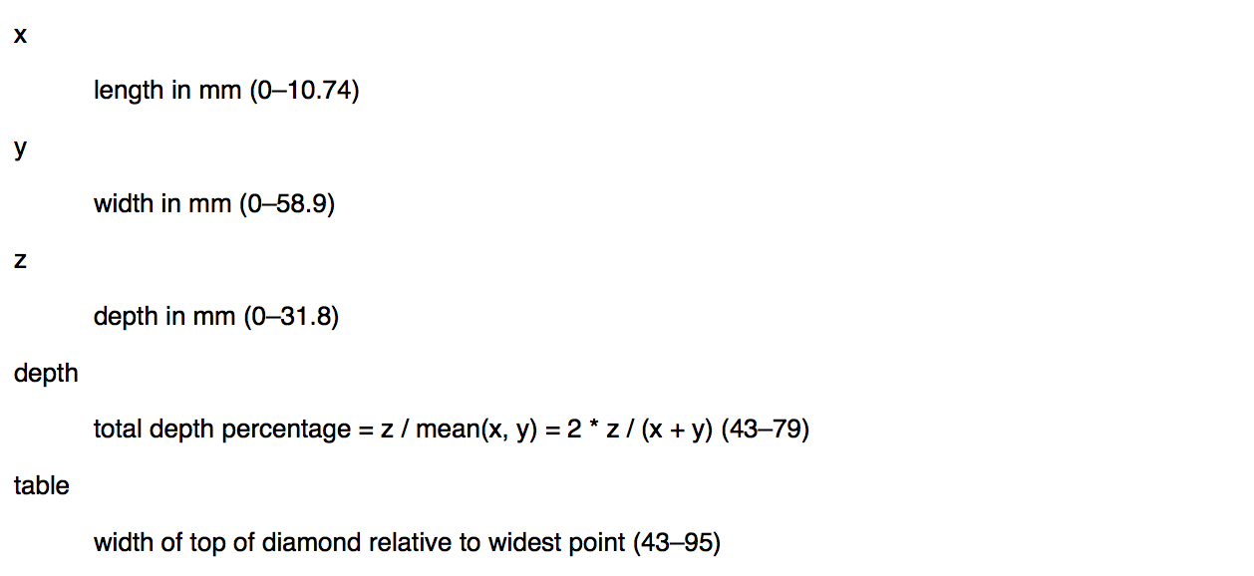
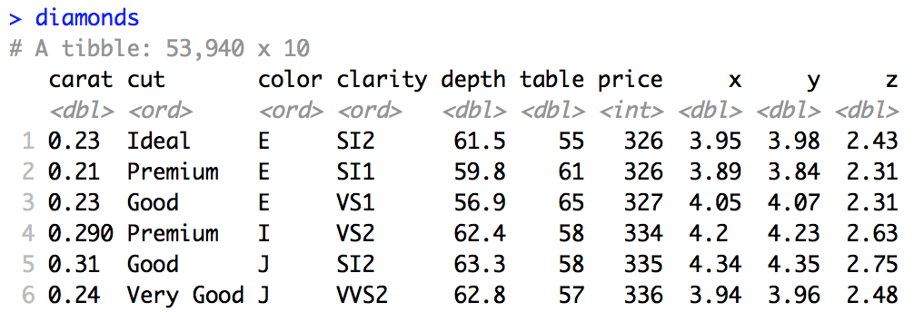
Diamonds

Slide 33
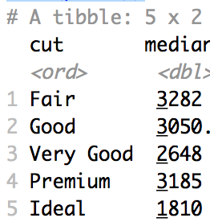
EDA | Diamonds
Let’s start by plotting the data… this is always a good (and recommended) place to start.
diamonds %>%
select(price, carat, cut) %>%
ggpairs(mapping = aes(color = cut))
Question 1 arises instantly!:
Fair looks to have the highest median price and Ideal looks to have the lowest! Why?
diamonds %>%
group_by(cut) %>%
summarize(median = median(price))

Slide 34
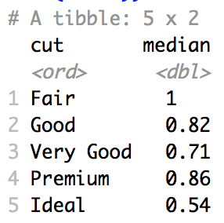
EDA | Diamonds
Question 2: (Posed in an effort to answer question 1.)
What is the relationship between cut and carat?
Judging from the boxplots and the histograms, it looks like the ideal diamonds have the smallest median carat. Let’s verify:

Slide 35
EDA | Diamonds
Question 3: (Posed in an effort to answer question 1.)
What is the relationship between price and carat?
Judging from the scatterplot of price v. carat, there looks to be a positive relationship between the two. Let’s replot to put carat on the x axis and price on the y axis.
diamonds %>%
ggplot(aes(x = carat, y = price)) +
geom_point()

Slide 36
EDA | Diamonds
Question 3: (Posed in an effort to answer question 1.)
What is the relationship between price and carat?
There certainly looks like overwhelming evidence of a positive relationship. We also discovered an odd pattern in the data … this may spawn a new question and new insight. We will stick with our original question for now.

Slide 37
EDA | Diamonds
Question 4: (Posed in an effort to answer question 1.)
If we account for the carat, will we see what we expect with respect to the cut and price?
It is a little evident here as the yellow (Ideal) tends to the top of the plot (higher price) and the purple (Fair) tends to the bottom of the plot.
We can use regression to actually take out the effect of the carat on the price so we can directly look at cut versus price (after accounting for carat) …

Slide 38
EDA | Diamonds
Question 4: (Posed in an effort to answer question 1.)
If we account for the carat, will we see what we expect with respect to the cut and price?
We take the log – log transformation in order to fulfil the assumption of the simple linear regression model (linear relationship between price and carat with equal standard deviation of log(price) conditional on log(carat).
diamonds %>%
mutate(lcarat = log(carat), lprice = log(price)) %>%
ggplot(aes(x = lcarat, y = lprice)) +
geom_point()
There is an interesting band at log price = 7.4 or so… that would spawn a new question for me… but again … we will stay on question 1 … but we would come back to this question as part of the EDA…

Slide 39
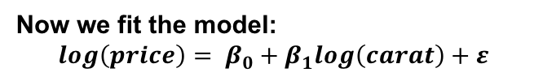
EDA | Diamonds
Question 4: (Posed in an effort to answer question 1.)
If we account for the carat, will we see what we expect with respect to the cut and price?
Now we fit the model:
$$log\left(price\right)= β_{0}+β_{1}log\left(carat\right)+ε$$
diamonds %>%
mutate(lcarat = log(carat), lprice = log(price)) %>%
ggplot(aes(x = lcarat, y = lprice)) +
geom_point() +
geom_smooth(method = "lm") +
ylim(c(5.5, 10))
residual = observed – expected …
residual = price of each black dot – corresponding point on blue line.
The residuals contain information the other variables have about price with the effect of carat removed.

Slide 40
EDA | Diamonds
Question 4: (Posed in an effort to answer question 1.)
If we account for the carat, will we see what we expect with respect to the cut and price?
Now we fit the model:
$$log\left(price\right)= β_{0}+β_{1}log\left(carat\right)+ε$$
diamonds %>%
mutate(resids = exp(fit$residuals)) %>%
ggplot(aes(x = carat, y = resids)) +
geom_point()
residual = observed – expected …
residual = price of each black dot – corresponding point on blue line.
The residuals contain information the other variables have about price with the effect of carat removed.

Slide 41
EDA | Diamonds
Question 4: (Posed in an effort to answer question 1.)
If we account for the carat, will we see what we expect with respect to the cut and price?
Now we fit the model:
$$log\left(price\right)= β_{0}+β_{1}log\left(carat\right)+ε$$
diamonds %>%
mutate(resids = exp(fit$residuals)) %>%
ggplot(aes(x = carat, y = resids, color = cut)) +
geom_point()
It still looks like the yellow tend to the top and the purple tend to the bottom (with some notable exceptions that will be further EDA opportunities!)
But lets get clearer visual evidence.

Slide 42
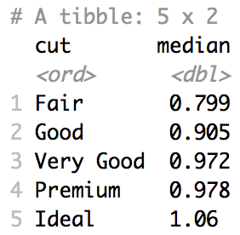
EDA | Diamonds
Question 4: (Posed in an effort to answer question 1.)
If we account for the carat, will we see what we expect with respect to the cut and price?
diamonds %>%
mutate(resids = exp(fit$residuals)) %>%
ggplot(aes(y = resids, color = cut)) +
geom_boxplot()
diamonds %>%
mutate(resids = exp(fit$residuals)) %>%
group_by(cut) %>%
summarise(median = median(resids))
We now have strong visual evidence that the price of the diamonds, after accounting for carat, is greater for the Ideal cut diamonds than the Fair cut diamonds.

Slide 44
Appendix 2: Outliers and Missing Values

Slide 45
Outliers and Unusual Values

Slide 46
Outliers and Unusual Values
Reasons
Errors
Recording Error (Typo)
Measurement Error
News Science
New Variables
New Relationships
Treatment
DO NOT AUTOMATICALLY DELETE OUTLIERS.
Run the analysis with and without outliers.
If not significantly different, leave them in.
If significantly different, investigate the outliers further

Slide 47
mpg: Outliers and Unusual Values
#Find unusual city mpg values
library(ploltly)
p = mpg %>%
ggplot(aes(x = cty)) + geom_histogram()
ggplotly(p)
#Find unusual city mpg values
library(ploltly)
p = mpg %>%
ggplot(aes(y = cty)) + geom_boxplot()
ggplotly(p)
Notes:
DO IT BY CLASS AS WELL TO CHECK FOR POSSIBLE ERROR.

Slide 48
Flights: Outliers and Unusual Values
#Find unusual arrival delay values
library(ploltly)
p = flights %>%
ggplot(aes(x = arr_delay)) + geom_histogram()
ggplotly(p)
#Find unusual arrival delay values
library(ploltly)
p = flights %>%
ggplot(aes(y = arr_delay)) + geom_boxplot()
ggplotly(p)

Slide 49
Diamonds: Outliers and Unusual Values
#Find unusual carat values
library(ploltly)
p = diamonds %>% ggplot(aes(x = carat)) + geom_histogram()
ggplotly(p)
#Find unusual y values
library(ploltly)
p = diamonds %>% ggplot(aes(x = y) + geom_histogram()
ggplotly(p)
#Check if they are Potentially Errors or just Outliers.
diamonds %>%
mutate(priceFact = cut(price, breaks = c(0,2000,10000,15000, 19000), labels = c("Low","Medium", "High", "Very High"))) %>%
ggplot(aes(x = carat, fill = priceFact)) +
geom_histogram()

Slide 51
EDA | Missing Values

Slide 52
Missing Values / NA = Not Available
Identify Missing Values (”NA”)
Numerical
Categorical
Mark Known Errors as NA.
Numerical
Categorical

Slide 53
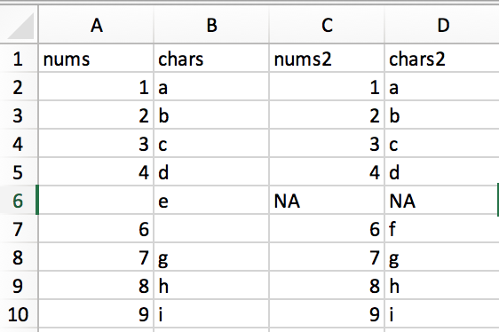
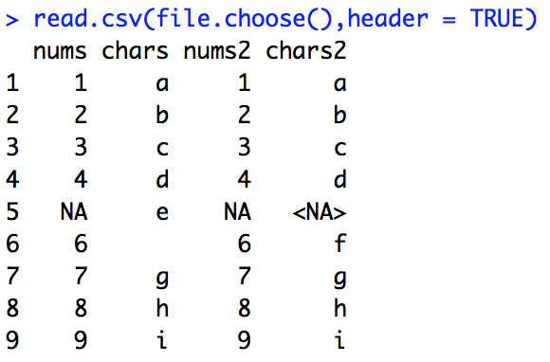
Missing Value | “” v. NA. v. <NA>

Slide 54
Missing Value | “” v. NA. v. <NA>
# Bring in MissingValueToy.csv as ’a’
a = read.csv(file.choose(),header = TRUE)
# count missing values in each column
s = sapply(a, function(x) sum(is.na(x)))
# Make all missing values NA
a$chars = ifelse(a$chars == ",",NA,a$chars)
a$chars2 = ifelse(a$chars2 == ",<NA>",NA,a$chars2)

Slide 55
Missing Values | identify | FIFA
library(naniar)
gg_miss_var(fifa[,1:40]) + ylim(0,75)
gg_miss_var(fifa[,41:89]) + ylim(0,75)
sapply(fifa, function(x) sum(is.na(x)))

Slide 56
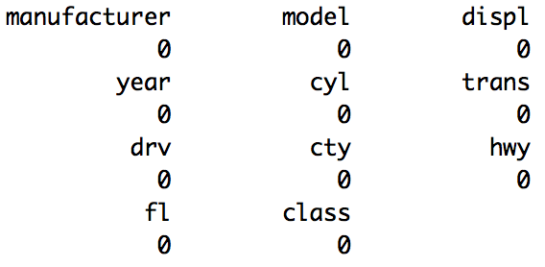
Missing Values | identify | mpg
library(naniar)
gg_miss_var(mpg) + ylim(0,10)
sapply(mpg, function(x) sum(is.na(x)))

Slide 57
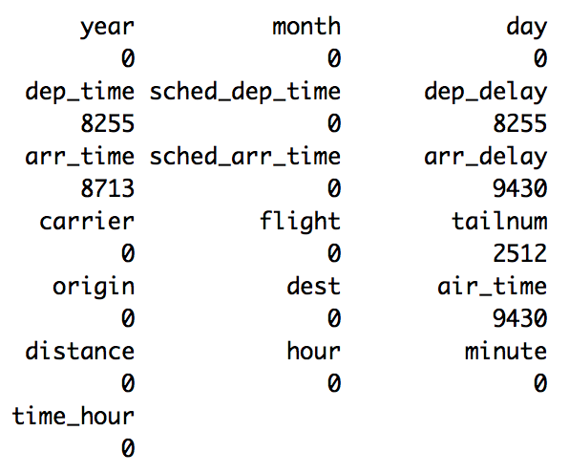
Missing Values | identify | flights
library(naniar)
library(nycflights13)
gg_miss_var(flights)
sapply(flights, function(x) sum(is.na(x)))

